Slide 1
CG MINI PROJECT
AIR HOCKEY GAME

Slide 2
Introduction
In this project we present to you a fun, relaxing and a competitive game that you can play with your friends during your free time anywhere even without an internet connection.
This is not just any ordinary air hockey game, it is filled with interesting perks and abilities which we will explain further in this presentation.

Slide 3
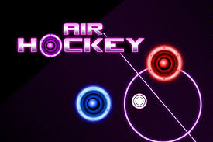
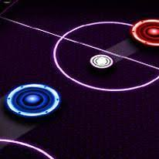
Problem Statement
To create a fun and easy to play air hockey video game, that supports a local 2-player mode along with smooth graphics.

Slide 4
Objective
To successfully create an interactable graphics window with smooth movements and animations for the air hockey video game using the pygame module in python.
To also add some innovative features to the game.

Slide 5
SCOPE
A two-player game that can be played offline with your friends.
The features added make it an interesting competitive game.
Something different from the ordinary air hockey game.
It trains us with our hand eye co-ordination.

Slide 6
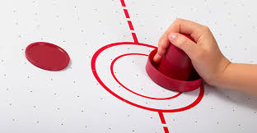
Existing System with Limitations
The normal air hockey game can be pretty monotonous, which can get boring after a few rounds.
It just involves 2 pucks with a constant velocity and the same goals.

Slide 7
Proposed system Methodology
First, using display function of pygame we create the main game window. Then we draw the center lines and goals to create the arena using rectangle, line and circle functions and the puck using the blit function.
We then display and set the score counters for both the players. We also create functions to pause the game and show the result once the game ends.
The main features that we added were speed-up and variable goal-size.
When a player scores the goal, he’ll get the advantage that his speed will increase and also we increase his goal size so that the game remains balanced.

Slide 8
RULES
Movement:
Player 1 uses WASD keys to move.
Player 2 uses the arrow keys to move.
Scores:
The player to score the first 5 goals wins.
Goals are counted once the disc touches the goal line.
Power-ups:
The player who scores gets his paddle speed increased.
The goal size of the player who scores increases.

Slide 9
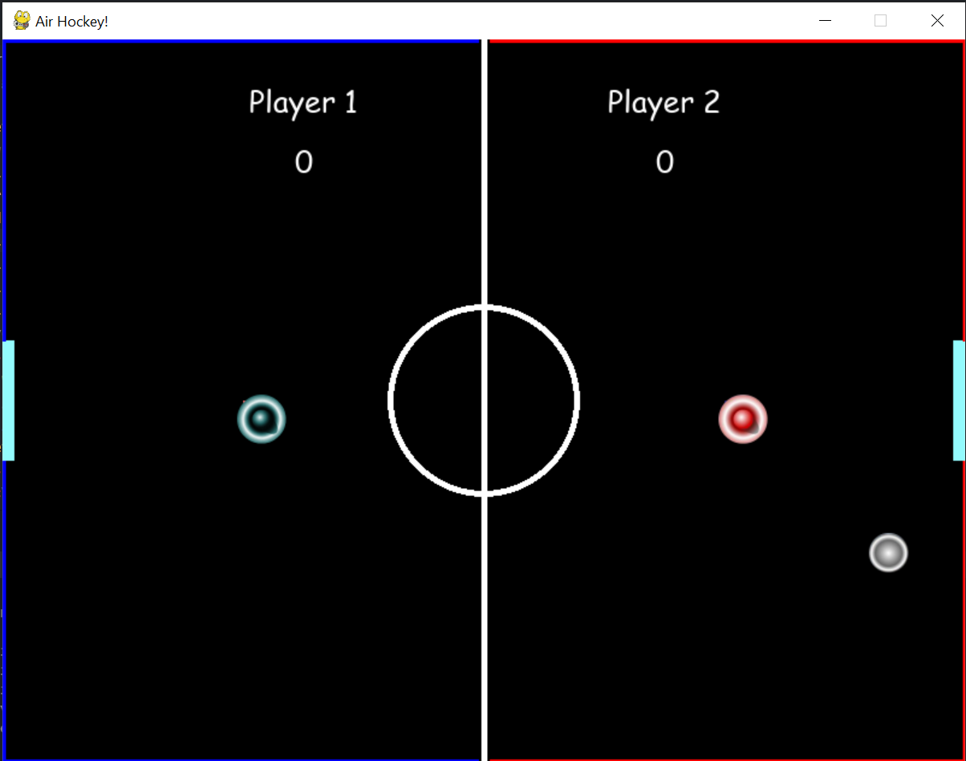
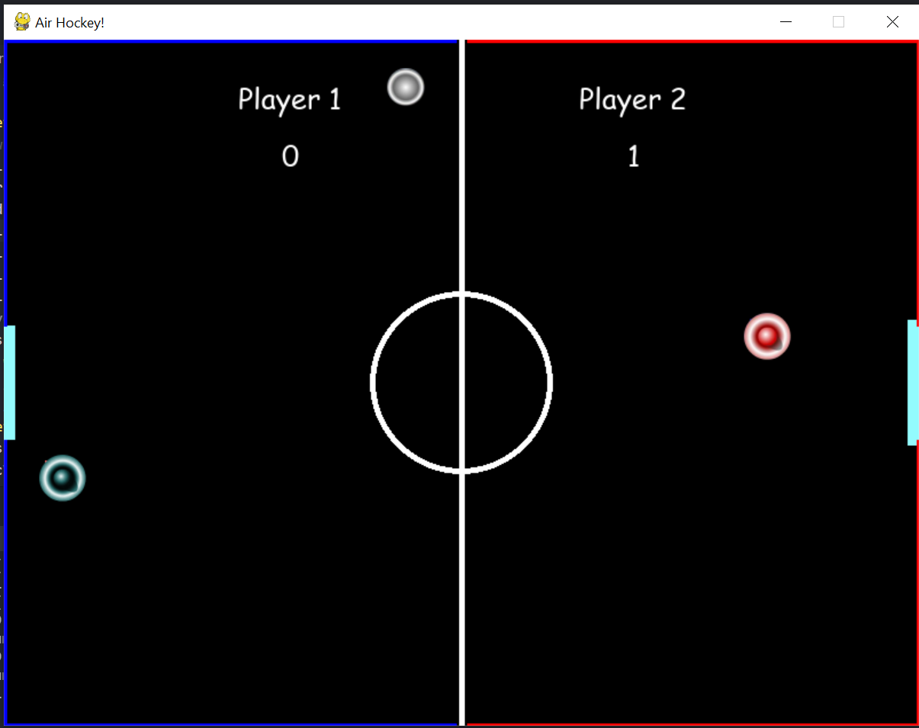
Output

Slide 10
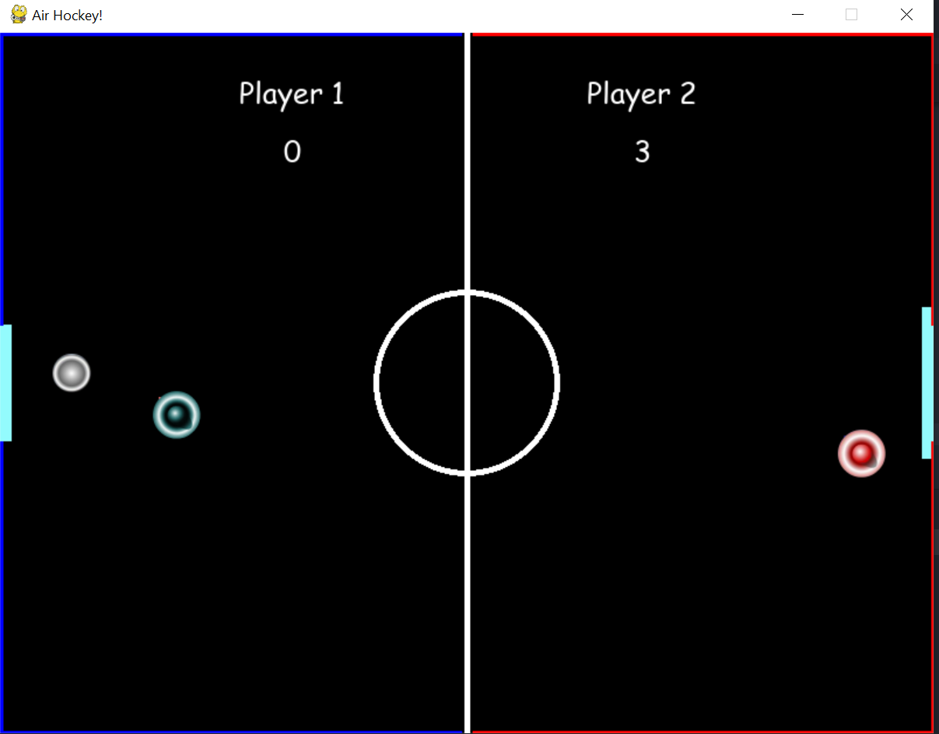
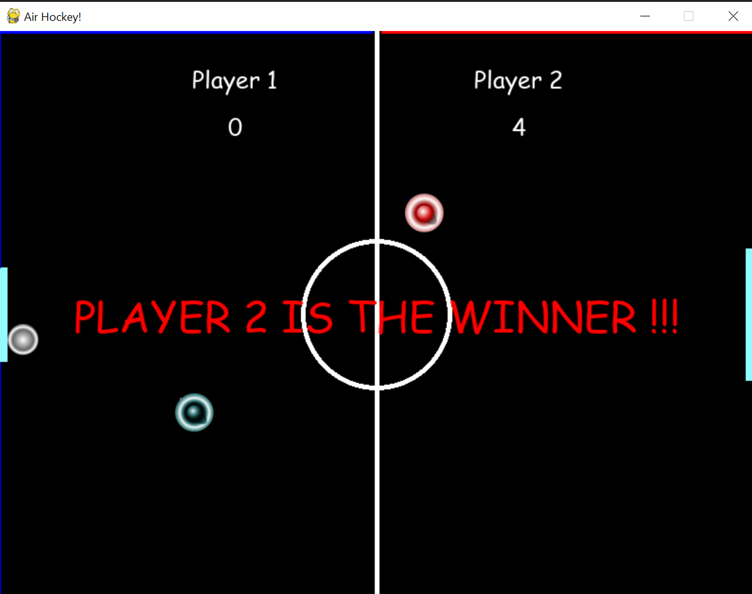

Slide 11
Conclusion
Thus we successfully learned to implement pygame library and its functions.
And we also successfully created an air hockey game using pygame and added some unique features to it.

Slide 12
Future Work
Got well-accustomed with python and its pygame library.
Also got hands on experience in creating a game.
With this knowledge that we gained, we can create more advanced and interesting games for future projects.
In the future we can add certain animations when the goal is scored and even some more power ups.

Slide 13
Reference
https://play.google.com/store/apps/details?id=com.mobirix.airhockey&hl=en_IN&gl=US
https://www.twoplayergames.org/game/air-hockey
https://www.pygame.org/docs/
https://docs.python.org/3/

Slide 14
Thank you
Eric Fernandes
Kedar Adhikari
Ryan Valiaparambil

